Slide 1
Flatiron Data Science Phase 1 Project
Madeleine Reiser
August 24, 2021

Slide 2
Outline
● Business Problem
● Data
● Results
● Conclusions

Slide 3
Business Problem
Microsoft wants to create their own movie streaming service
What types/genres of movies make the most money in the box office?

Slide 4

Results

Slide 5
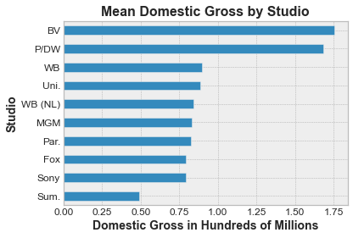
Results
BV: $ 175,240,200
P/DW: $ 168,290,000
WB: $ 89,799,160

Slide 6
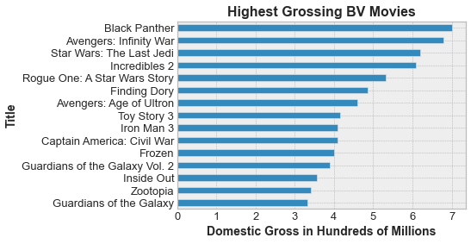
BV Studios
Black Panther: $700,100,000
Avengers: Infinity War: $678,800,000
Star Wars: The Last Jedi: $620,200,000
Incredibles 2: $608,600,000
Rogue One: A Star Wars Story: $532,200,000

Slide 7
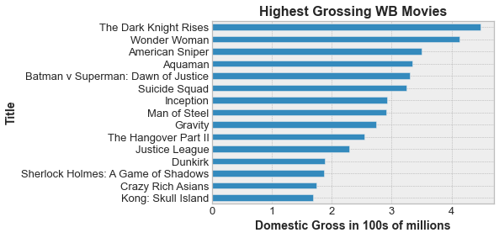
WB Studios
The Dark Knight Rises: $448,100,000
Wonder Woman: $412,600,000
American Sniper: $350,100,000
Aquaman: $335,100,000
Batman v Superman: Dawn of Justice: $330,400,000

Slide 8
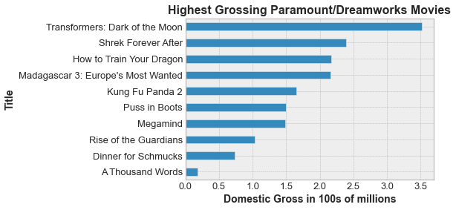
Paramount/Dreamworks Studios
Transformers: Dark of the Moon: $352,400,000
Shrek Forever After: $238,700,000
How to Train Your Dragon: $217,600,000
Madagascar 3: Europe's Most Wanted: $216,400,000
Kung Fu Panda 2: $165,200,000

Slide 9
Conclusions
Adventure/Drama/Sport films make the most money in the Domestic Box Office, invest in live sporting events.
Action/Adventure/Sci-fi and Action/Adventure/Animation films are the 2nd and 3rd most profitable genres, those with sequels do the best.
Because Documentaries are the highest rated genre, invest in these as well, for recognition and awards.
In the future, data from 2019 onward would be interesting to look at to see how the film industry was affected by the Covid-19 Pandemic and how they adapted.

Slide 10
Thank you!
Email: reiser.mb@gmail.com
GitHub: @turtleduck18

